Slide 1
AePW-3 Telecon
November 7, 2019

Slide 2
Agenda: Nov 7, 2019
AIAA SciTech
Inquiry made to AIAA-Applied Aero TC regarding possibility of discussion sessions at 2020 SciTech (Jan): Survey of working groups suggests that Tuesday evening is best option. Awaiting AIAA concurrence.
High-speed FSI group led by Dan Bodony expects to meet Monday, January 6th, at 7 pm at SciTech. Members of Hypersonics Working Group have been added to that meeting’s distribution list.
Review of Oct meeting
Hypersonics Working Group: report from 1st telecon
Large Deformation Working Group: report from 1st telecon
High angle of attack Working Group:
Telecons held Thursday Oct 17 & Oct 31
Next telecon Thursday Nov 14, 11 a.m.
High Deformation Working Group
Next telecon Wednesday Nov 13, 11 a.m.
High Fidelity CFD workshop discussion: Stephen Wood
Next telecon Dec 5, 2019

Slide 3
Notes from October telecon
Hypersonics Working Group: report from 1st telecon
Large Deformation Working Group: report from 1st telecon
High angle of attack Working Group meeting: Oct 17, 2019, 11 am.
Inquiry made to AIAA-Applied Aero TC regarding possibility of discussion sessions at 2020 SciTech (Jan) and Aviation (June) conferences. Surveying working group members wrt day and time.
High Fidelity CFD workshop discussion planned for next telecon
Next telecon Nov 7

Slide 4
Hypersonics FSI Working Group
Telecon held on 10/04/2019.
Attendees
Duke University: Prof. Earl Dowell, Kai Bastos, Kevin McHugh
USAFA: Adam Jirasek
ATA Engineering: Eric Blades
Identified classes of problems
Discussed experiments and reference data sets
Discussed goals of workshop

Slide 5
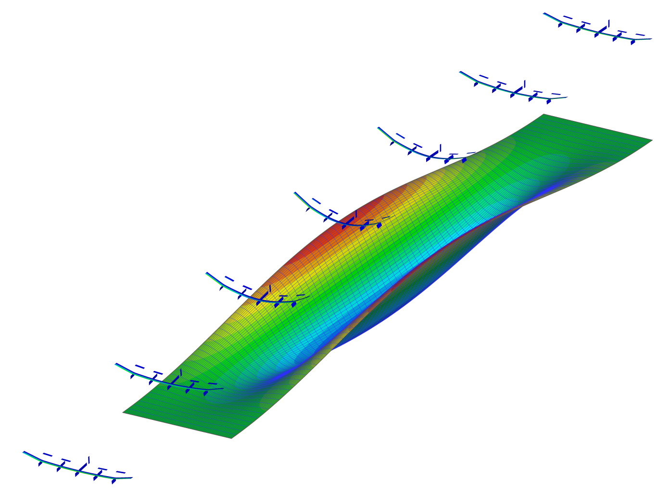
Large Deflection Working Group
The 1st telecon was held Sept 25, 2019
17 member group
This group will primarily focus on nonlinear aeroelasticity regarding large (nonlinear) structural deflections and their impact on the system
Motivations, topics, ideas, etc. were discussed and some test cases were presented
The test cases from Duke University and Technion gained the most interest
Participants agreed to contribute to the Technion Benchmark Wing and the UoB AWI-HARW
DLR and TU Delft offered to support collaborative experiments of the Technion Wing by testing this model in their wind tunnel (TU Delft would also do a GVT)

Slide 6
High Angle of Attack Working Group Report
Telecons held Oct 17 and 31
Members asked to bring test cases forward
Definition of High Angle of Attack: Most agreed that we are using the phrase synonymously as “separated flow”
Most agreed that transonic region is the primary region of interest
NASA Benchmark Models cases presented. Slides are being posted to website at https://nescacademy.nasa.gov/workshops/AePW3/public/wg/highangle
Next telecon: Thursday Nov 14, 11 am.

Slide 7
High Deformation Working Group
From Daniella Raveh (email 11/7/2019)
Yesterday we assembled the wing and performed GVT and a static loading test (without the polyester wrap and instrumentation). We’ve loaded it to the max wing root moment it will encounter in the WT test, just to make sure it doesn't break it in the tunnel (although the deflections in the WT will be much smaller, with the distributed load). Wing tip deflection in the picture is about 70% of the span. When the load was taken off the wing returned to the undeformed shape.
We are working on summarizing all the analyses and test data in a document to share with you all.

Slide 8
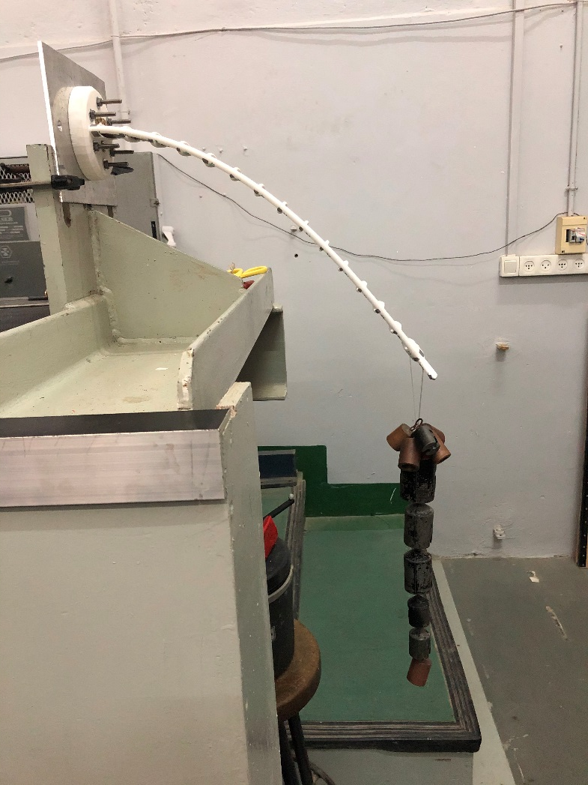
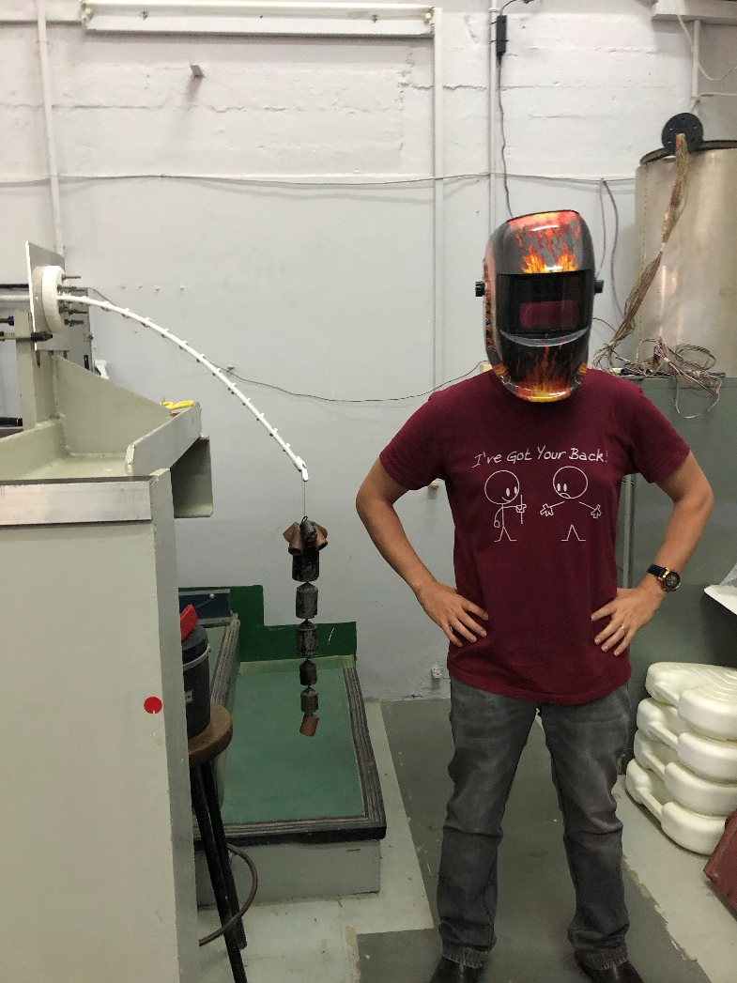

Slide 9
Moving Forward with the Aeroelastic Prediction Workshop 3
Telecon Notes
Sept 9, 2019

Slide 10
Notes from Sept 12 2019 Telecon (Page 1/3)
Next telecon will be on Oct 10 (rather than on Oct 3 which is the first Thursday) in recognition of German Unity (or Unification?) Day
Webex: when the webex link comes up, there is an incorrect telecon number that is displayed.
Reviewed the survey. 9 parties had responded. Discussion of expanding the survey. Jens added more categories on the fly. Bret reminded us that he was taking the lead on the google poll which would maybe help us to identify what product(s) do each of us want to get out of a workshop? Whereas the existing (and complementary) poll is more focused on what physics do we care about. Should the poll be expanded or does the current one make it easy to observe trends and extract data?
Website landing page isn’t public-facing yet, and it only contains telecon information currently. Please try to access it again next week.

Slide 11
Notes from Sept 12, 2019, (page 2/3)
Steve Massey reviewed the experimental test cases that have been sent to him to date. (Steve’s slides are included in these slides)
High fidelity CFD workshop was mentioned and briefly discussed. We will ask Steve Wood, one of the organizers of that workshop, to discuss that workshop including planned test cases. Multi-purpose discussion: technical synergies, organizational aspects, possible participation
Based on initial survey feedback, formed 3 ad hoc exploratory working groups.

Slide 12
Notes from Sept 12, 2019 Telecon (Page 3/3)
Working groups- ad hoc exploratory phase groups?
Large Deformation Working Group tentative membership (Carlos to coordinate initial email): Carlos Cesnik, Markus Ritter, Daniella Raveh, Jonathan Cooper, Earl Dowell, Kevin McHugh, Kai Bastos
Hypersonics (Eric Blades to coordinate initial email): Eric Blades, Adam Jirasek, Kevin McHugh, Kai Bastos, Earl Dowell) Note that there may be interest from the High Fidelity CFD group.
High angle of attack (Jen Heeg to coordinate initial email): Jen Heeg, and all those who have taken the survey except Markus (who is the only one who didn’t select this as an area of interest)
Expectations from these groups
None?
Item on the agenda of the next telecon to see if they have exceeded expectations
Exchange emails or have discussions to try and find common ground, objectives, tests cases, other good things

Slide 13
Survey progress & path forward
https://doodle.com/poll/gbxvw3u4ispqetz5
Suggest defining a suite of cases as shown for the high fidelity CFD workshop
Possible collaboration and participation in high fidelity CFD workshop

Slide 14
Website progress
https://nescacademy-s.larc.nasa.gov/workshops/AePW3/public/

Slide 15
Collaboration format
Objective of workshops: Collaborate in an effective manner, getting the most return for time investment.
Prior workshops were patterned after Drag Prediction Workshop. This is not a requirement, but rather has been a choice. We are free to make a different choice.
Workshop and workshop process?
Collaborative workspace that can naturally leads to a workshop?

Slide 16
Objectives of the Aeroelastic Prediction Workshop
Assess the goodness of computational tools for predicting aeroelastic response, including flutter
Understand why our tools don’t always produce successful predictions
Which aspects of the physics are we falling short of predicting correctly?
What about our methods causes us to fall short of successful predictions?
Establish uncertainty bounds for computational results
Establish best practices for using tools
Explicitly illustrate the specific needs for validation experimentation- i.e. why what we have isn’t good enough
Establish community for leveraging experiences and processes

Slide 17
Survey of unsteady aerodynamic experimental data sets
Send technical reference papers on data sets acquired since 2005
Unsteady aerodynamics
Flutter
Buffet
LCO
Send to steven.j.massey@nasa.gov

